Slide 1
SAPRAA
Financial Report 2012

Slide 2
SAPRAA funds as at 29 Feb 2012
Money Market Account:
Cheque Account:
Total:
R 248 980
R 56 555
R305 535

Slide 3
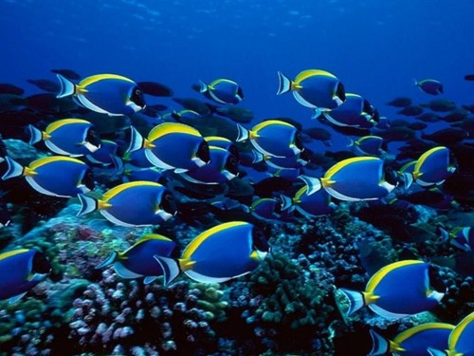
Deficit for 2012
- R 19 195

Slide 4
Gross income
Year | 2012 [R] | 2011 [R] | Difference 2012 - 2011
Meeting fee income | 265 125 | 285 309
Website advertising | 3 500 | 5000
Current account interest | 709* | 352*
Money market account interest | 12 926* | 19 040* | [*Jan 2011 transfer of R60 000 from MM to CA]
Total | 282 260 | 309 701 | [- 27 441]

Slide 5
Expenditure
Year | 2012 [R] | 2011 [R] | Difference 2012 - 2011
Meeting venue expenses | 262 993* | 242 435 | *Southern African workshop fees
Speakers gifts and honoraria | 12 440** | 6000 | ** More paid speakers
Website administration costs | 6 757 | 5 099
Christmas meeting expense | 713*** | 4070*** | ***Cut backs
Total | 282 903 | 257 604 | [+ 25 299]

Slide 6
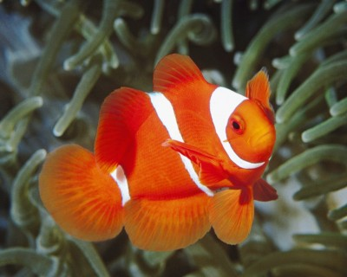
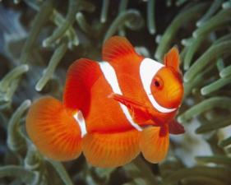
Conclusions
Non-profit organisation
Adequate financial reserves
Keep meeting fees as low as possible
Consider charging for Southern African workshops

